Slide 1
Exam Portal
A Comprehensive Platform for Exam Management

Slide 2
Introduction to the Exam Portal
What is the Exam Portal?
A centralized digital platform to manage exams and student academic data.
Designed for both students and administrators to easily access and manage exam-related information.
Purpose of the Portal
Simplifies the exam process, making it accessible, efficient, and transparent.
Provides a secure online platform for exam scheduling, admit cards, results, and more.

Slide 3
Benefits for Students
Convenience: Access exam details from anywhere, anytime.
Real-Time Updates: Stay informed about exam schedules, admit card availability, and results.
Error-Free Process: Automated features ensure fewer manual errors in exam data.

Slide 4
Benefits for Administrators
Efficiency: Simplifies scheduling, admit card distribution, and result posting.
Security: Safe and encrypted storage of sensitive exam data.
Data Analytics: Ability to generate performance reports and track student progress.

Slide 5
Screenshots

Slide 6
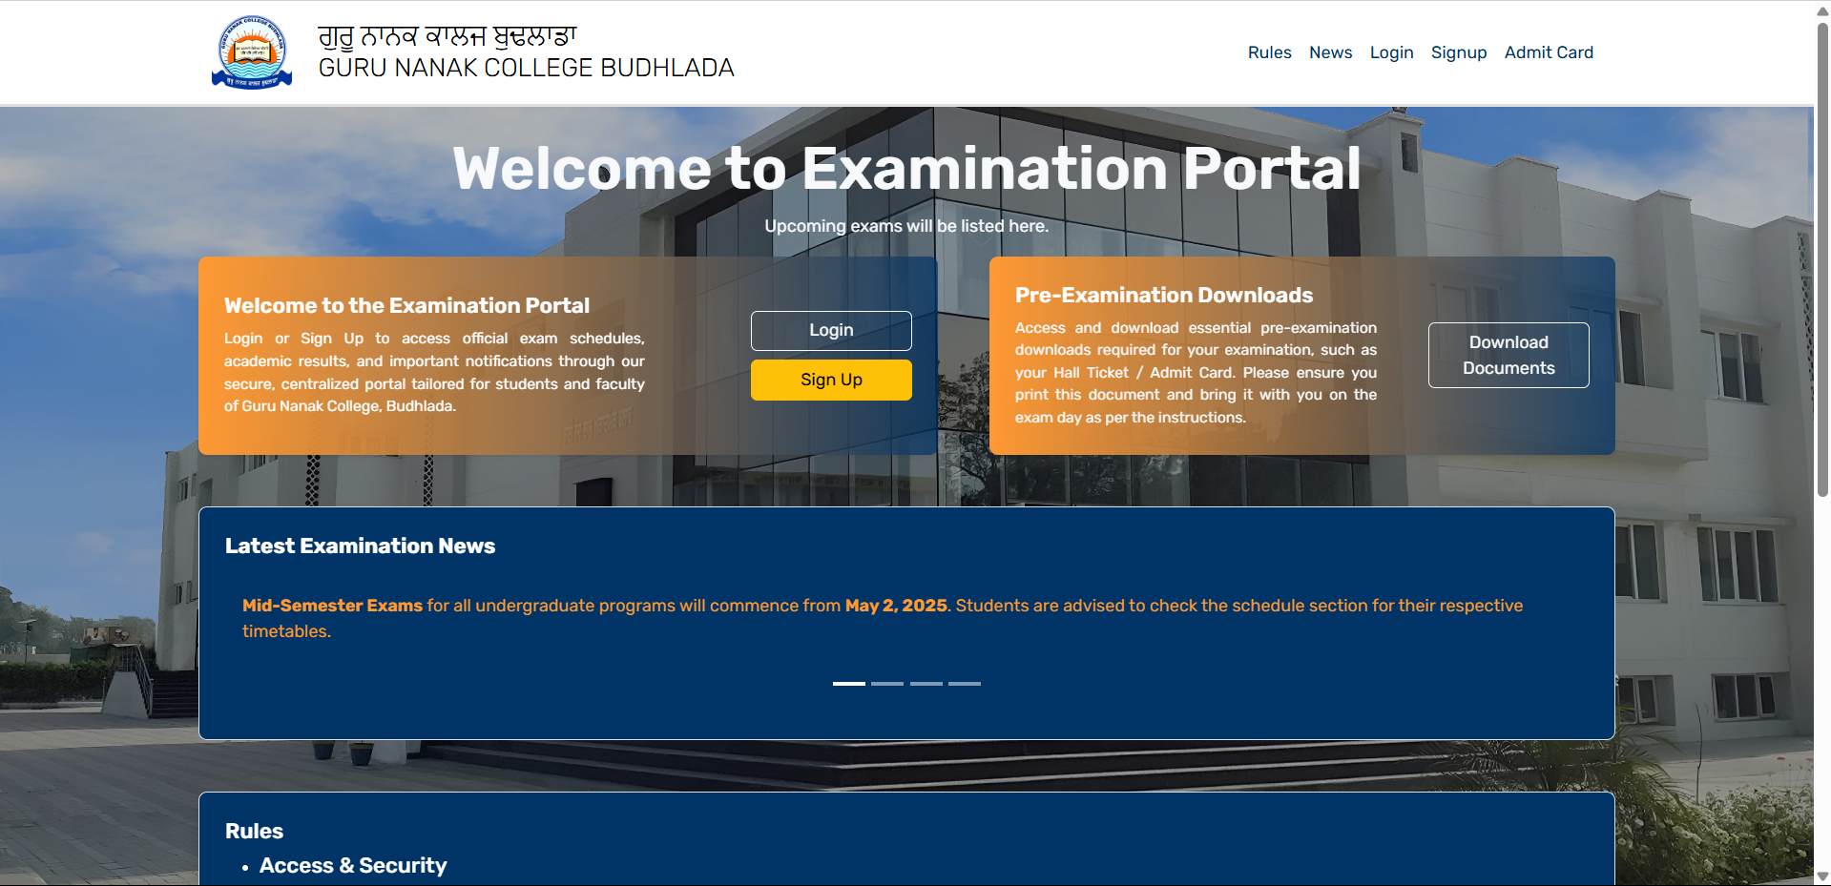
Home

Slide 7
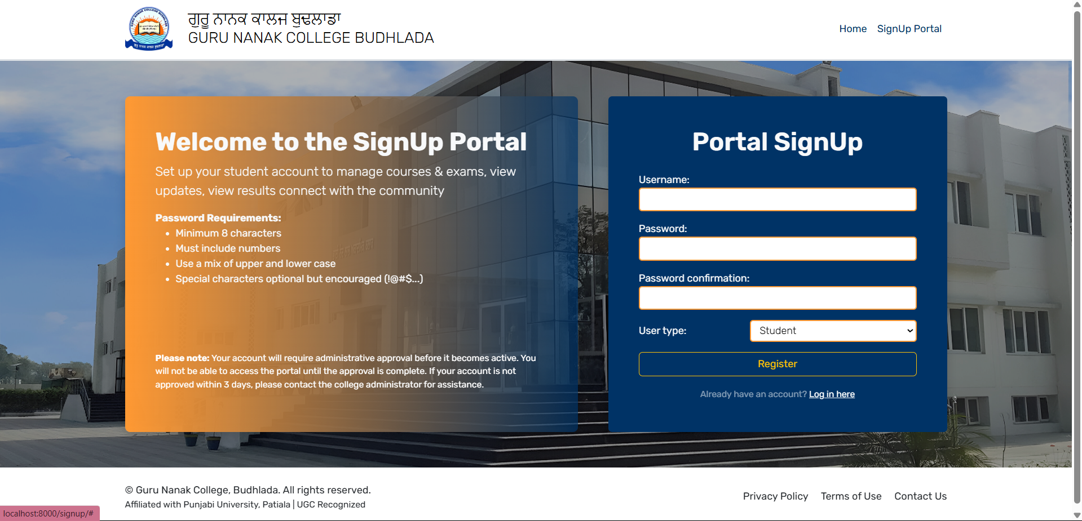
Signup

Slide 8
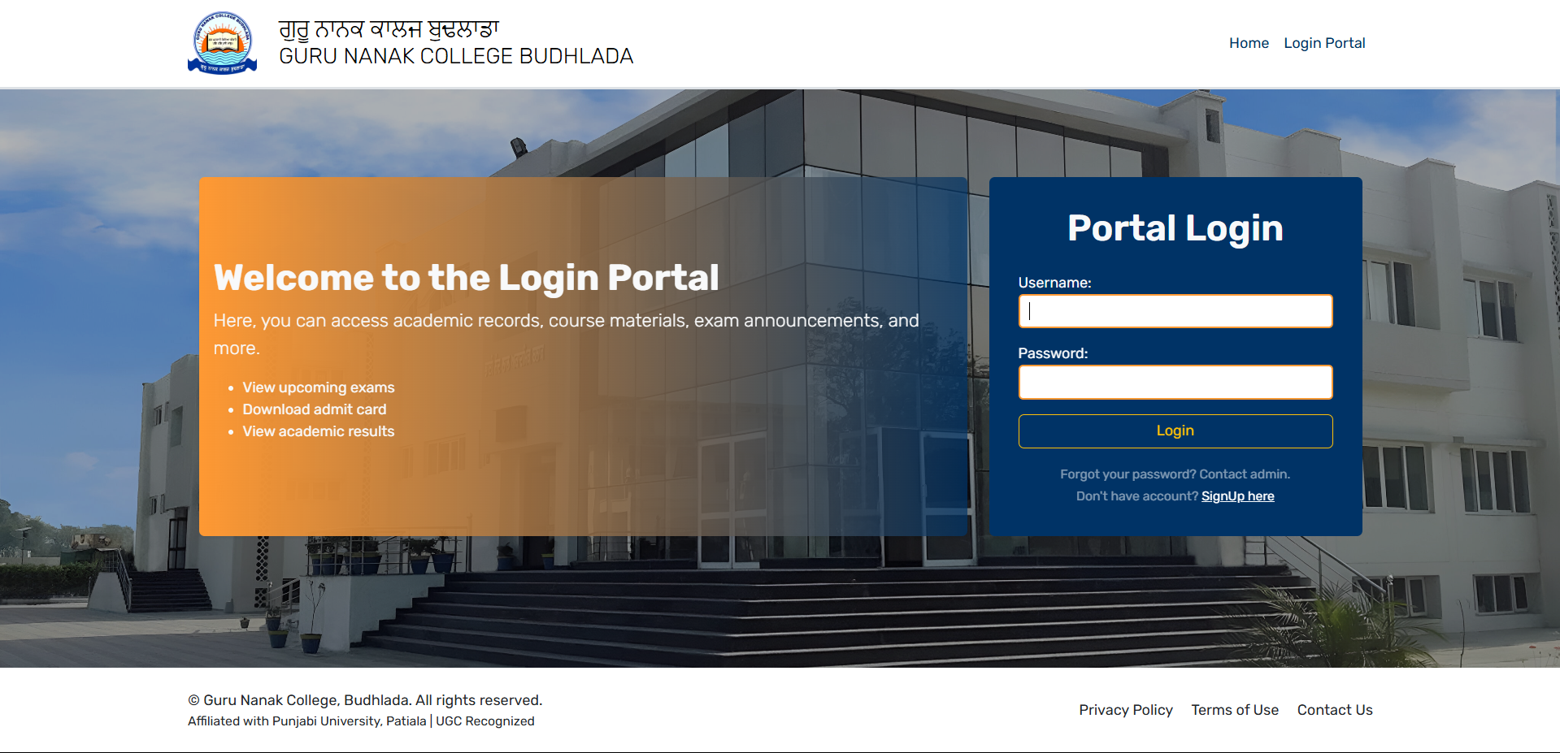
Login

Slide 9
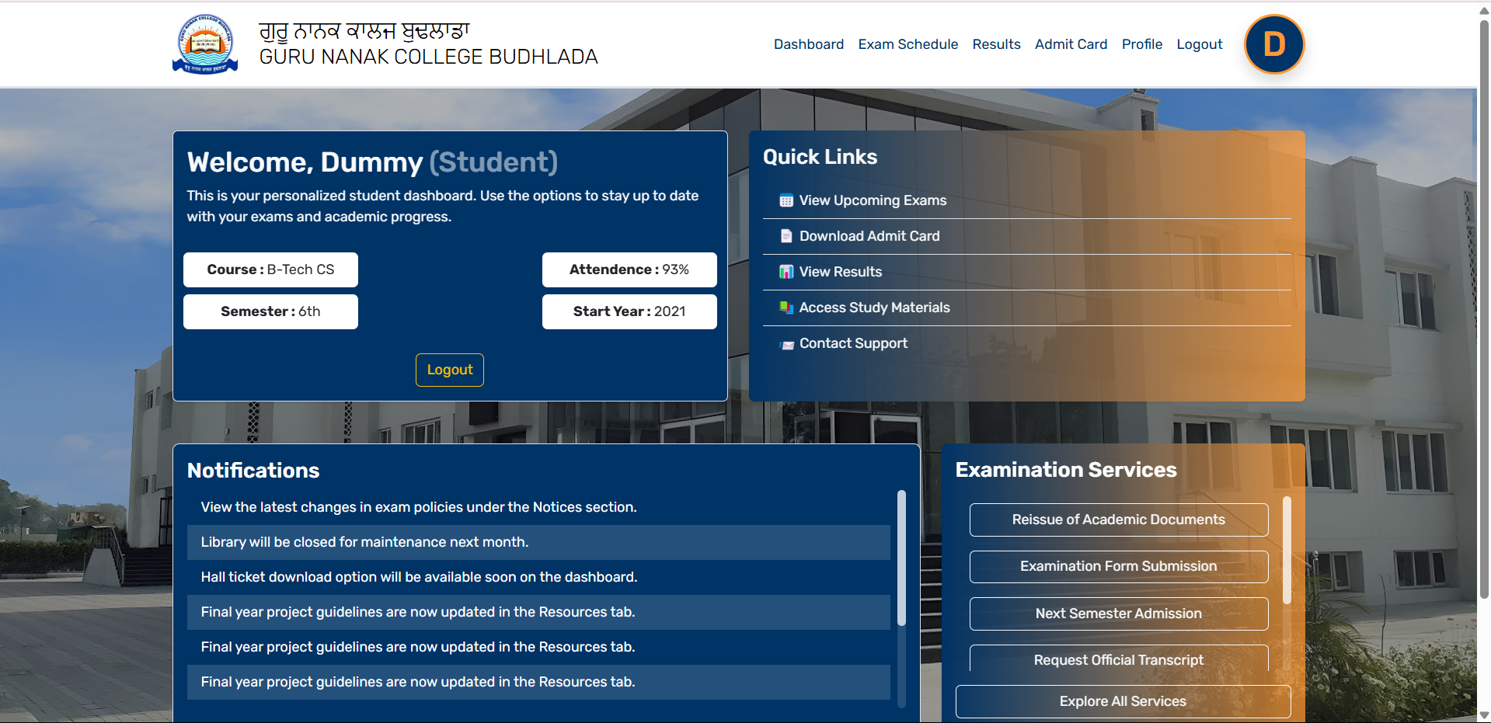
Student Dashboard

Slide 10
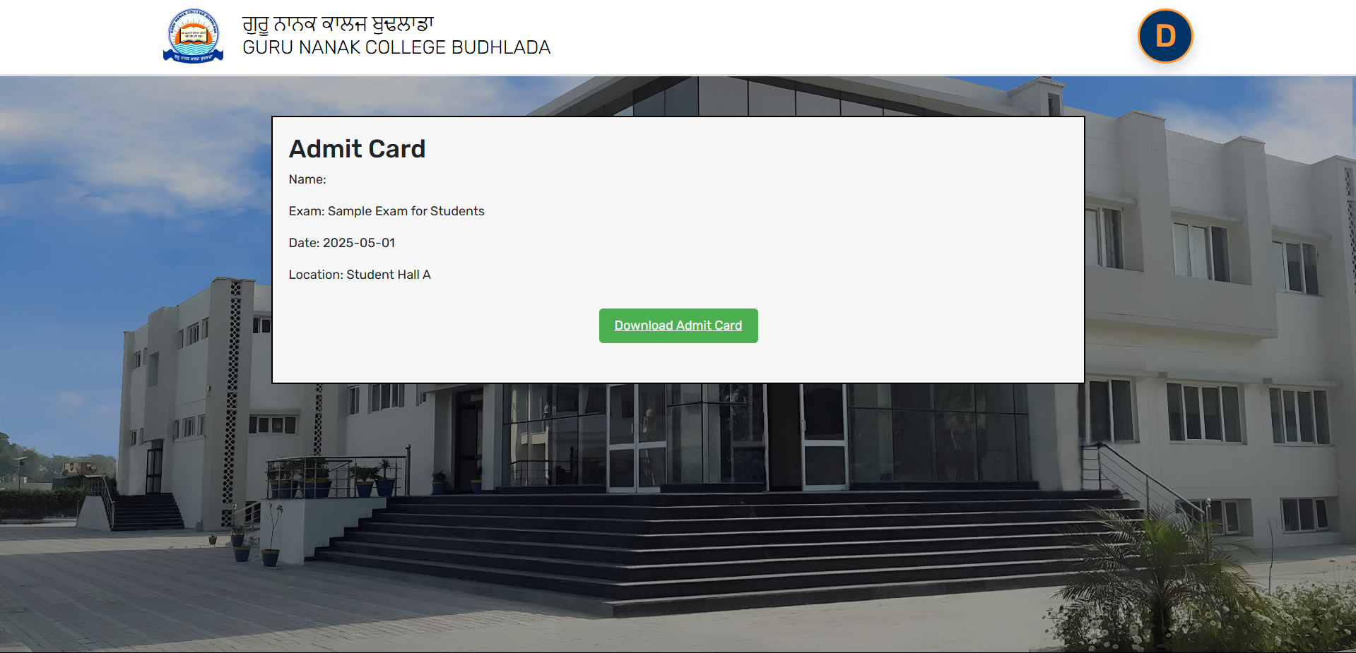
Admit Card

Slide 11
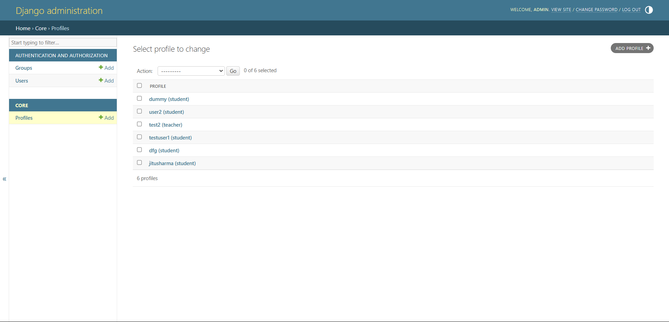
Admin

Slide 12
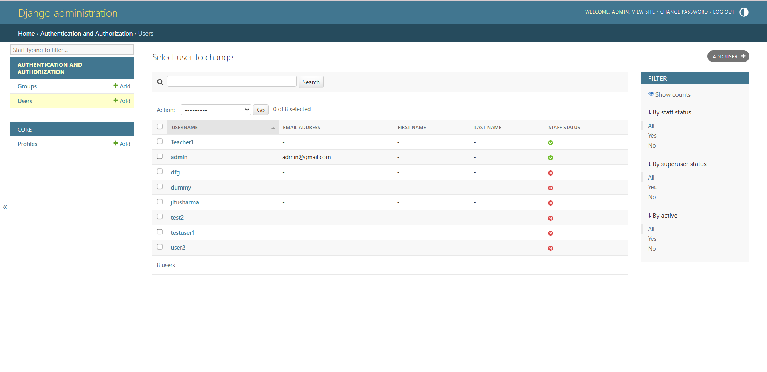
Admin (Users)

